Slide 1
Tanaji Sulagave
Data Analyst & Visualization

Slide 2
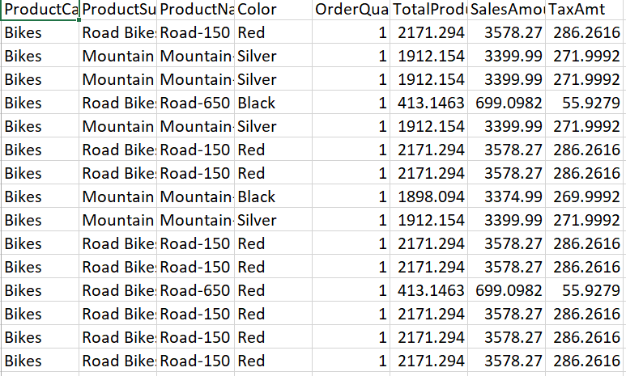
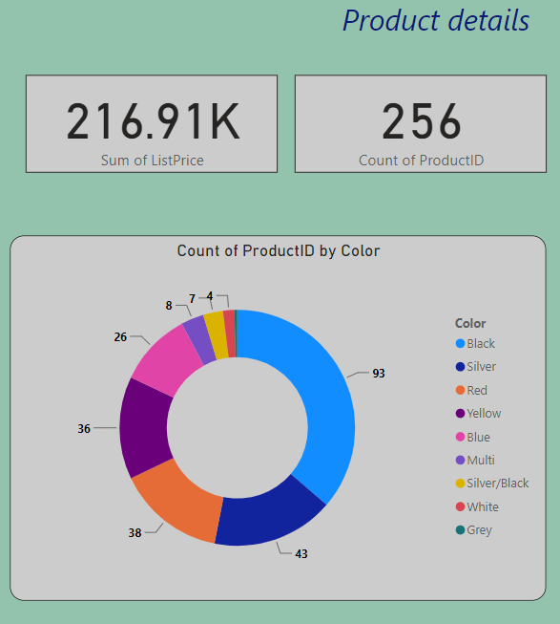
Why reporting / visualization technology required ?
End user / Client is not interested in your excel or CSV report, They required high level information for checking the details in your data.
A report is the basic management tool for making decisions and to help solve problems.
Excel file report
Power BI report

Slide 3
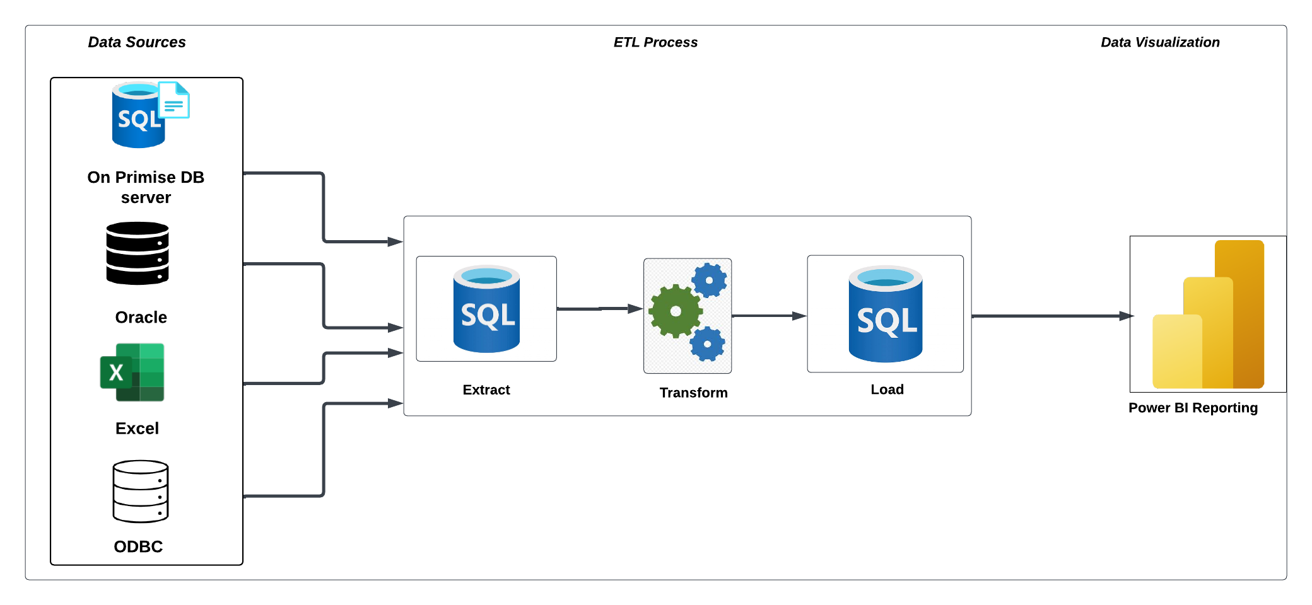
End to end flow of ETL to Visualization process
Extraction: The first stage in the ETL process is to extract data from various sources such as transactional systems, spreadsheets, and flat files. This step involves reading data from the source systems and storing it in a staging area.
Transformation: In this stage, the extracted data is transformed into a format that is suitable for loading into the data warehouse. This may involve cleaning and validating the data, converting data types, combining data from multiple sources, and creating new data fields.
Loading: After the data is transformed, it is loaded into the data warehouse. This step involves creating the physical data structures and loading the data into the warehouse.
Visualization:- Connecting data warehouse we will create a interactive report using reporting tool such as Power BI.

Slide 4
Basic Introduction of visualization and list of visualization tools
Data visualization is a graphical representation of data. It presents data as an image or graphic to make it easier to identify patterns and understand difficult concepts.
We have various visualization tools for representing the data.
Please find the below list of visualization tool and analytical tools
Microsoft Power BI
Tableau
SSRS
QlikView
Excel

Slide 5
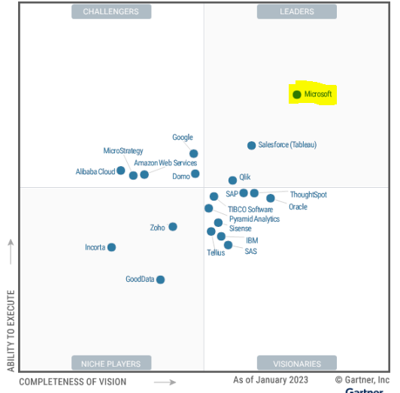
Comparison of BI Technologies

Slide 6
Comparison
Power BI Tool | Other Reporting tools
Power BI is generally considered easier to use for newer users and those who are not data analysts. | Other tools are hard to understand. Also very difficult to use the tools functionality.
Its starts at $9.99 per month per user. | Costly. The basic Creator bundle starts at $70 per month per user.
For development Power BI tool is free | Most of the other reporting tools not free for development we need License keys .
Month to month update provided by Microsoft | Rare update provided by other reporting tools
It has excellent data modeling capability | Other tool do not have data modeling capability.
Its used in Small, medium, and large Organization | Its used only in large organization

Slide 7

1) Introduction of Power BI

Slide 8
Power BI introduction
Power BI is a Data Visualization and Business Intelligence tool that converts data from different data sources to interactive dashboards and reports.
Power Bi provides cloud-based(BI) services.
It connect over 80+ data sources.
Power BI suite provides multiple software, connector, and services.
We have different types of componants in power BI.
Power BI Desktop - a free desktop application for building and designing reports.
Power BI Service - the online publishing service for viewing and sharing reports and dashboards.
Power BI mobile apps - for viewing reports and dashboards on the go.

Slide 9
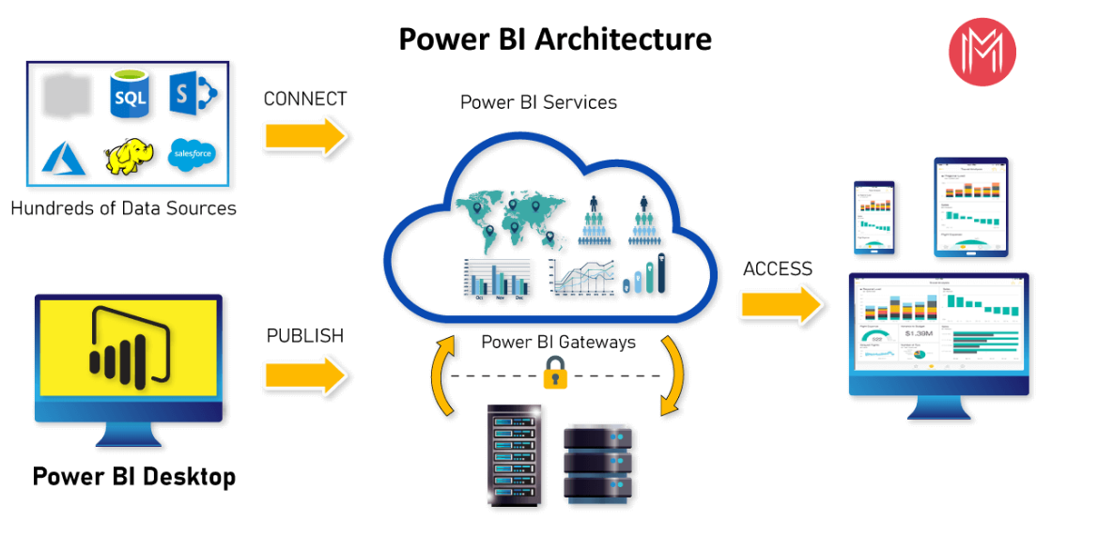
Architecture of Microsoft Power BI

Slide 10
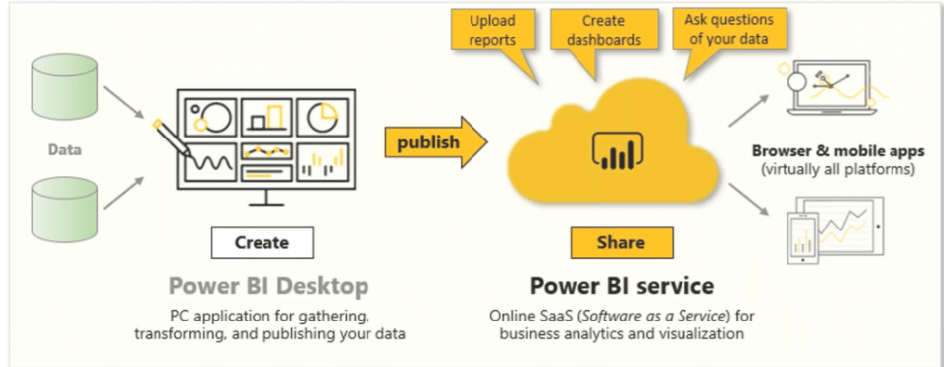
Power BI Common Flow
Bring data from multiple data-sources into power bi desktop.
Create a report using this data.
Publish this report on power bi service account.
Share the report / dashboard with others (end user).

Slide 11

Roles and Responsibilities in Organization
Understand business requirements in the BI context and design data models to convert raw data to meaningful insights.
To analyze data and present it through reports that can help in decision-making.
Create dashboards and visual interactive reports using power bi
Identify kpis with clear objectives and monitor them consistently
To perform Dax queries and functions in power bi.
To use filters and graphs for a better understanding of the data.
To perform SQL querying for best results (if knowledge on SQL)
Handle Power BI report / Dashboard deployment process in Dev, UAT and prod env.
Create document for reports to represent to end user with key insights.
Take care of data warehouse development.

Slide 12
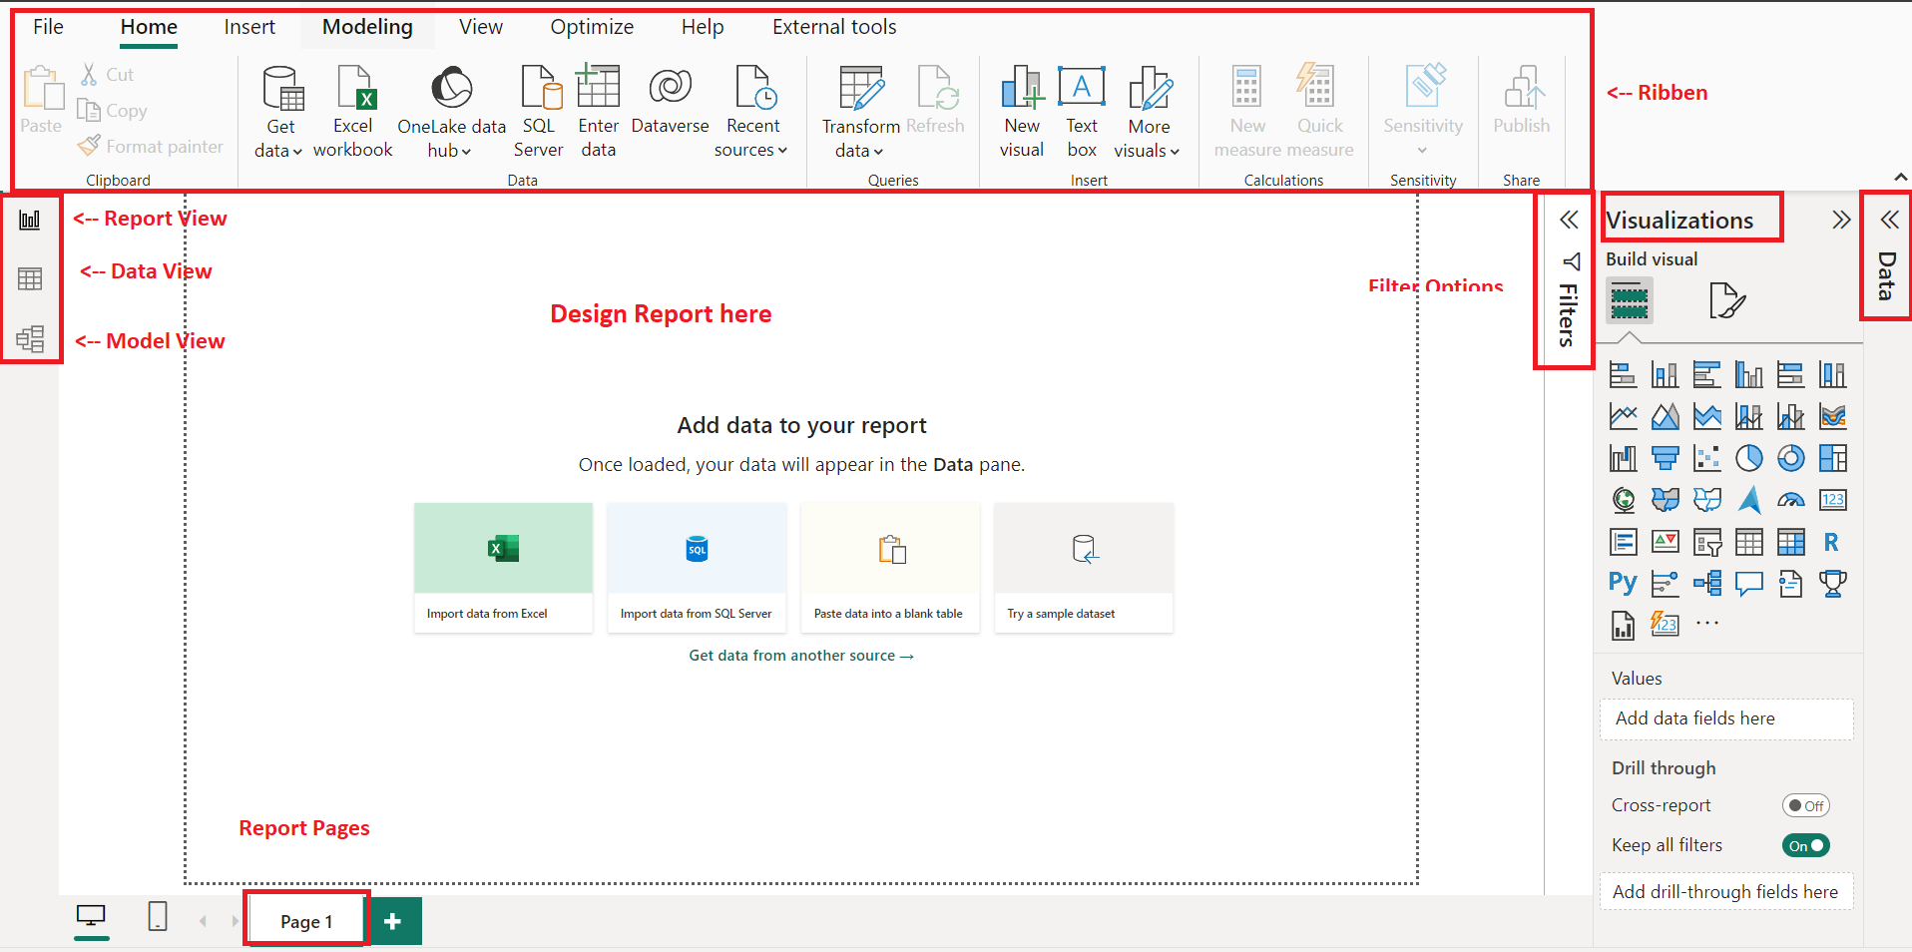
Power Bi tool Overview

Slide 13
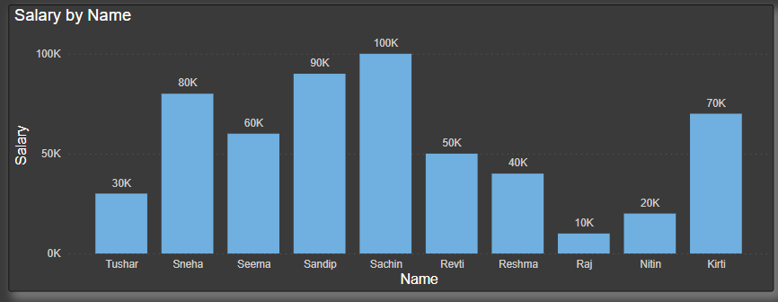
Building blocks of Power BI
The basic building blocks in Power BI are:
Visualizations
Datasets
Reports
Dashboards
Tiles
Visualizations:- Visualization means the visual representation of data. Live dashboards, interactive reports, maps, graphs, and other visual representations allow you to easily and efficiently access the main business insight.
Continue…

Slide 14
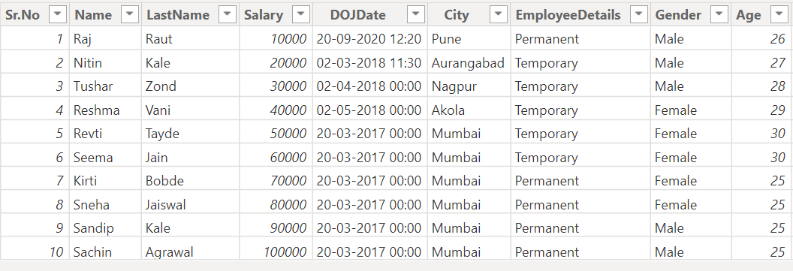
Dataset:- Dataset is a collection of data. A dataset is required to transfer data into information. Through datasets, you can create interactive reports and dashboards.
Datasets can also be a combination of different kinds of data sources like CSV, EXCEL, SQL Server, web, or many more. A dataset contains the data source and its credentials.
Continue…

Slide 15
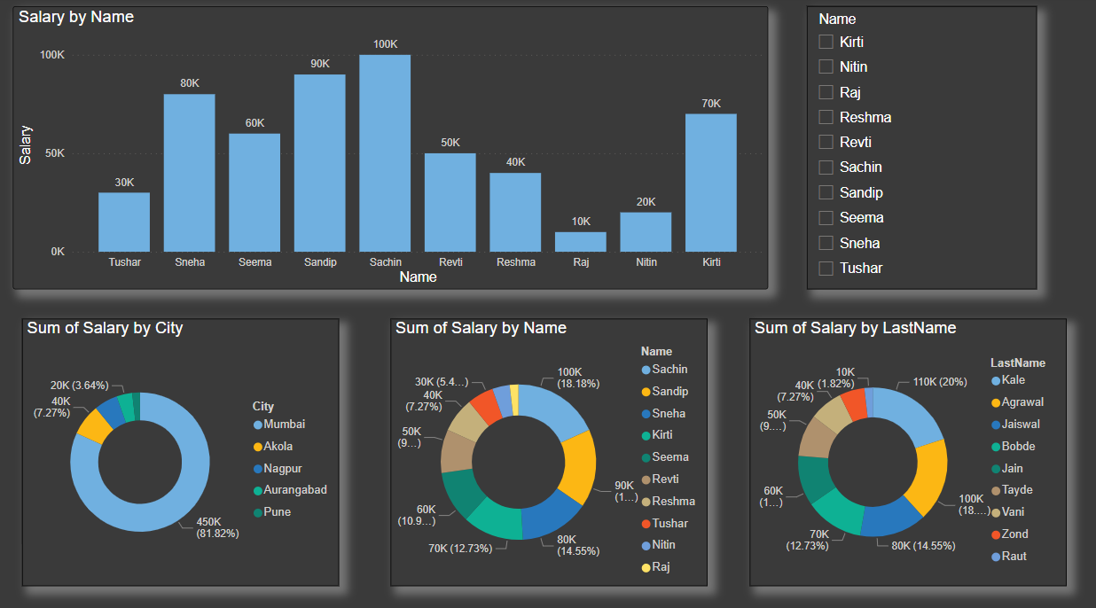
Report:- A Power BI report consists of one or more pages with visualizations.
With using data set you can create report a per the end user requirement.
Continue…

Slide 16
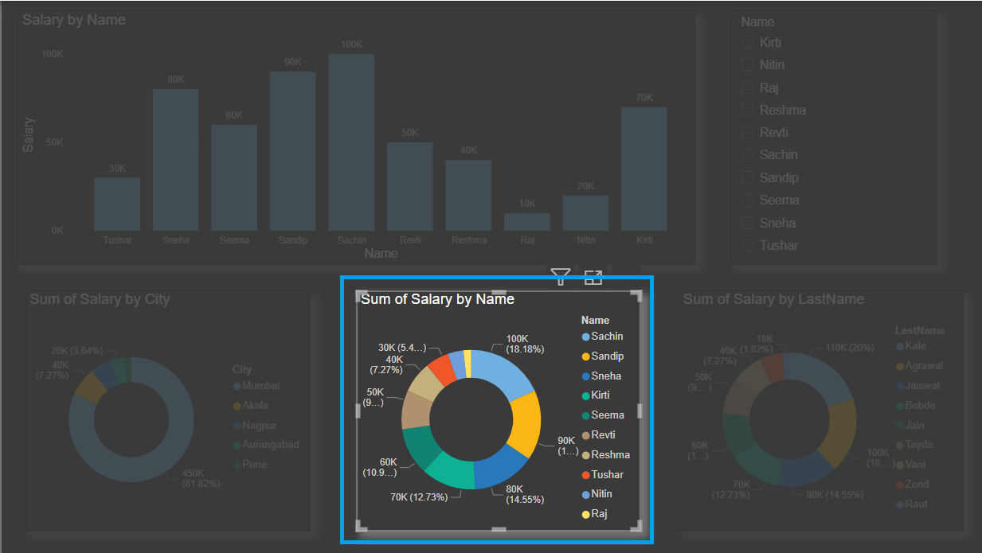
Dashboard:- with using reports you can create dashboard on Power Bi service.
The dashboard must fit on a single page.
Dashboards are collections of visuals and reports that provide a high-level summary of key metrics and insights.
Tiles:- It’s the rectangular box that contains every individual visual.
In single Power Bi report page we have different tiles.

Slide 17
2) Data Transformation

Slide 18
Data Transformation Overview
Date Transformation is a Converting raw formatted data into shaped format or ready to use format.
Power BI provide us various component for transforming the data.
Below are component available in Power BI.
Power Query:-
To clean data, Uses M functions, Requires more memory for M functions.
Bring and combine data (append, merge, join etc.) from various places.
Derive new columns of data.
Format, remove or reduce data.
Power Pivot :-
To do data modeling, Uses DAX functions.
set up relationships between tables
Power View :-
Power view is a data visualization technology that lets you create interactive charts, graphs, maps, and other visuals that bring your data to life.

Slide 19
Power Query Editor tool
Power Query is a Data Transformation and Data Preparation tool included with Microsoft Excel and Microsoft Power BI.
Power Query tool importing data from a various data sources like as Excel tables, CSV files, Database tables(SQL, Oracle , MS Access, MySQL, Cloud databases), Webpages, and so on, and allows you to transform your data into the proper shape and condition for better analysis.
Whenever we have added transformation on data steps insert and M code is changed.
With use of this transformed data we can create the Power BI report.
Please find the below sample examples of data transformation in Power query editor tool.
Change data type. First row as header
Choose column, Remove column, Keep rows, Remove rows, Change column Name.
Merge and Append queries.
Split column, Replace value.
Examples :- Please find the sample examples
Notes:
Provide the tools overview

Slide 20
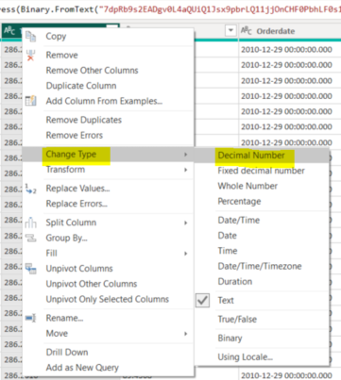
Examples
Data Type Change
Explain this in same example
Choose column
Remove column
Keep rows
Remove rows
Change column Name
First Row as header
Split Column
Replace value
Continue…

Slide 21
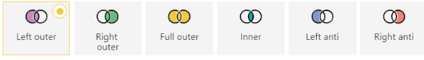
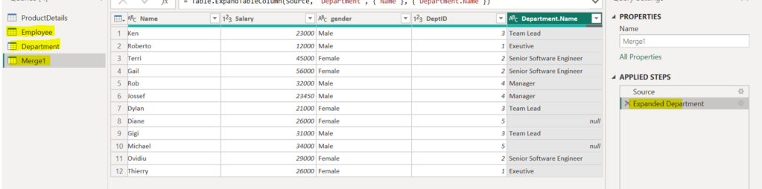
Examples
Merge Queries
A merge queries operation joins two existing tables together based on matching values from one or multiple columns.
This is same like SQL server joins .
Types of Merge queries:-
Continue…

Slide 22
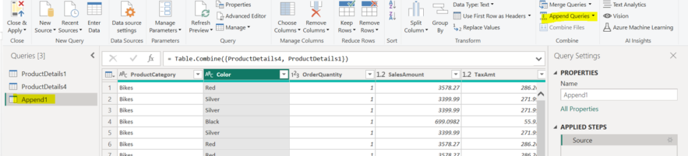
Examples
Append Queries
Append queries in Power BI can be a useful way to combine data from multiple sources and create single table.
The columns in both queries must match in terms of data type and order.
It is same like UNION in SQL server.
Continue…

Slide 23
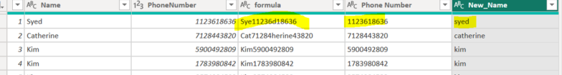
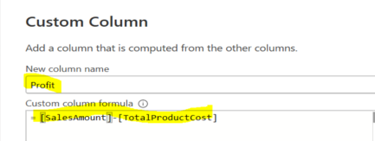
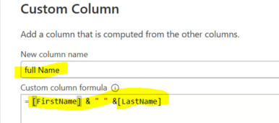
Examples
Column from example
Suppose we have one column we need to split as per the requirement then column from example best option to create it. Please find he below snap.
Custom Column
We need to add custom and use formula based on requirement also automatically steps add using M code

Slide 24
3) Relationships in Power BI

Slide 25
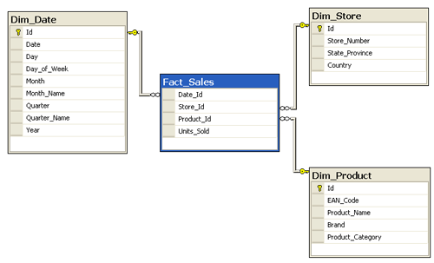
Fact and Dimension Table
Relationships like as connection between fact and dimension table.
Fact Table:-
A fact table is a table that stores the measurements, metrics, or facts related to a business operation.
Its located in Star and Snowflake schema. foreign/ reference keys available in fact table.
Fact table have various calculations and measures and store important information.
Dim Table:-
Dimension tables contain descriptions of the objects.
Dimension tables have a column that serves as a primary key and this key linked in fact table as a foreign key.

Slide 26
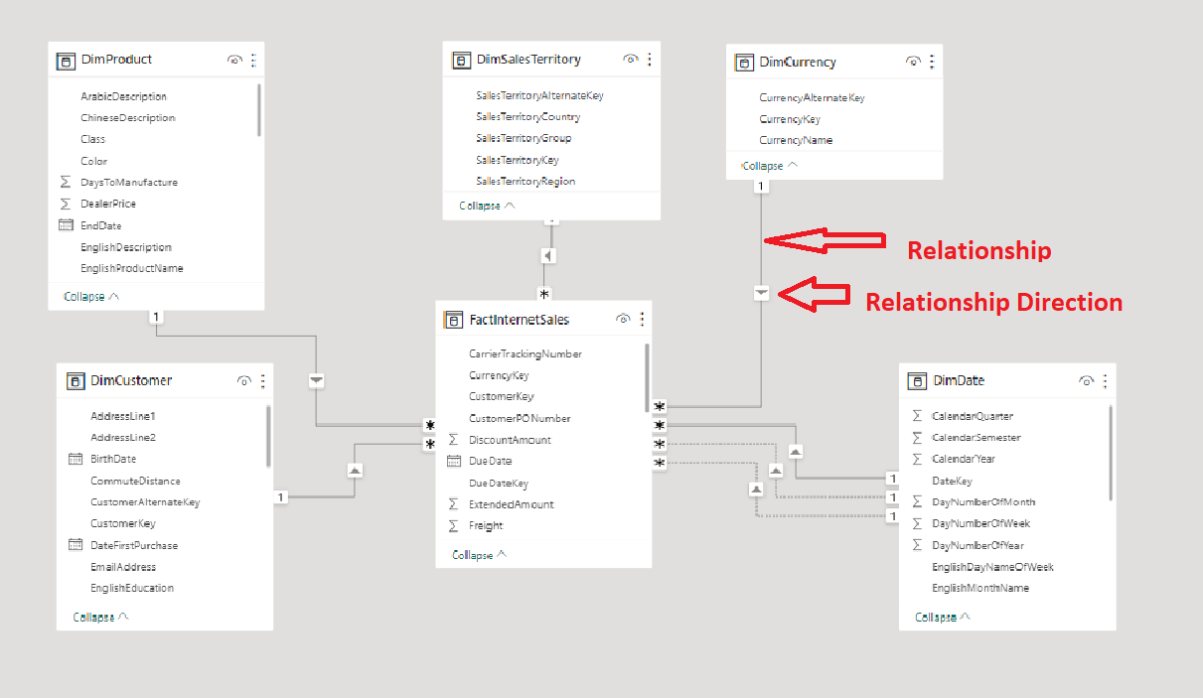
Why relationship is required example
Relationships between those tables are necessary to accurately calculate results and display the correct information in your reports.
If user need to create the relationship then go to Modeling and then Manage Relationship option

Slide 27
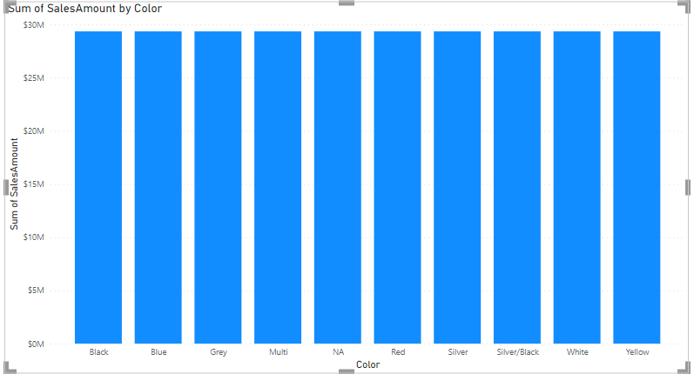
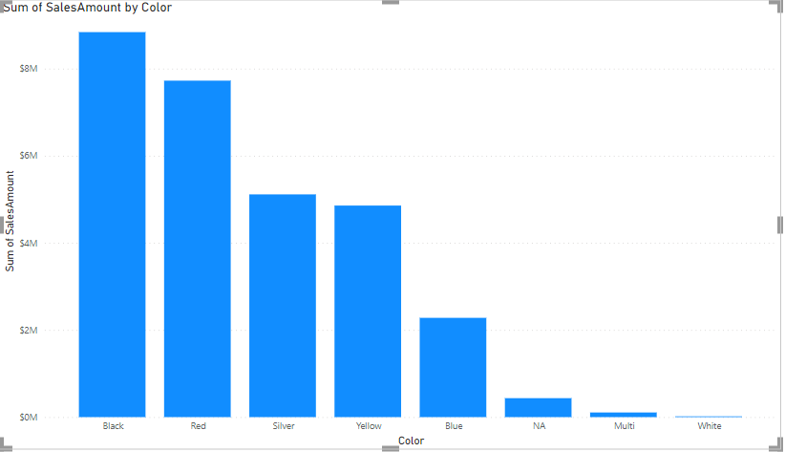
Example :- Use factInternetSales and DimProduct table and check the relationship
Without Relationship
With Relationship

Slide 28
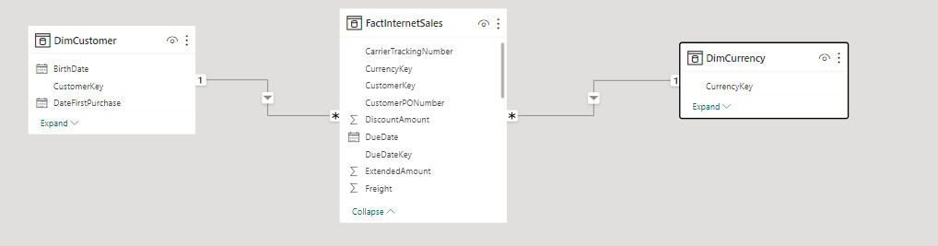
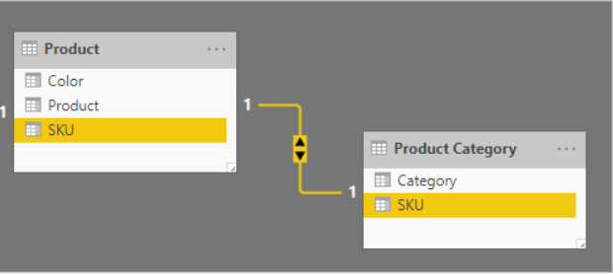
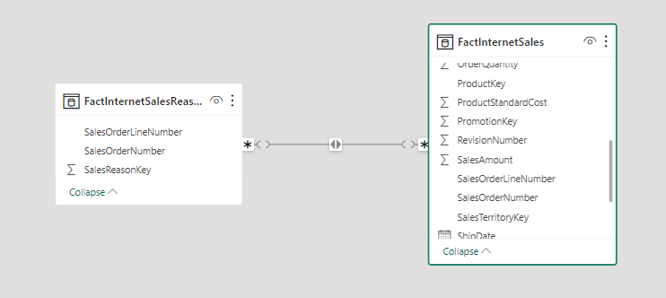
Relationships Types
In Power BI we have four types of relationships.
Many to one (*:1)= Top table have many records and bottom table have unique records
One to many(1:*) = Top table have unique records and bottom table have many records.
One to one (1:1)= Top and bottom table have unique values based on cardinality.
Many to many (*:*)= both side tables having many values.

Slide 29
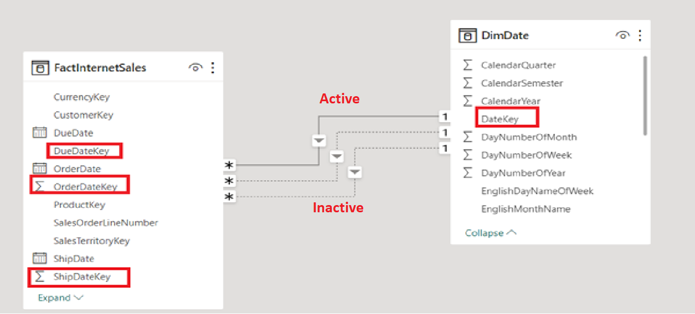
Active and Inactive relationships.
Suppose we have Date table and we need to fetch information based on OrderDate, DueDate, ShipDate with using sales fact table.
As per the below image we have 3 relationships between Sales and Date table 1 is active and rest are inactive.
Question:- How many relationships are active between 2 tables and We need to extract data as per the inactive relationship ?
Answer :- USERELATIONSHIP function.

Slide 30
4) Charts / Visualization

Slide 31
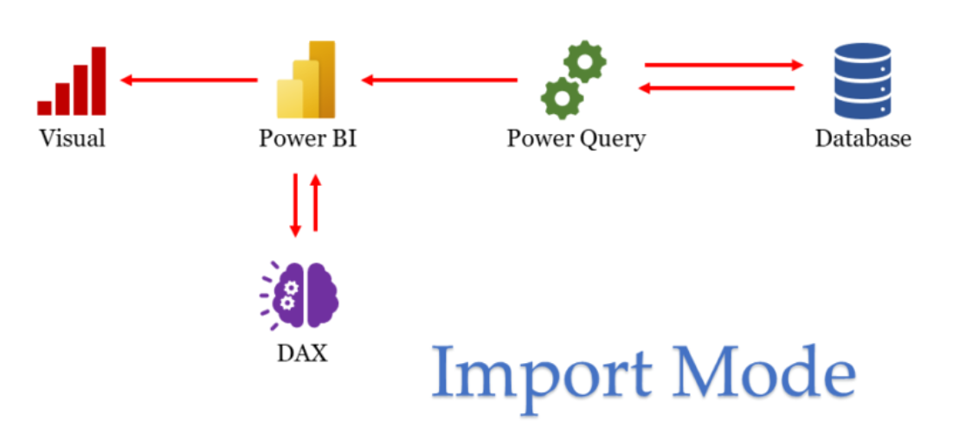
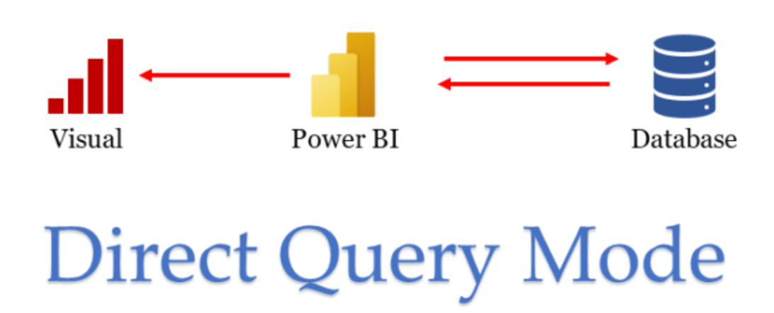
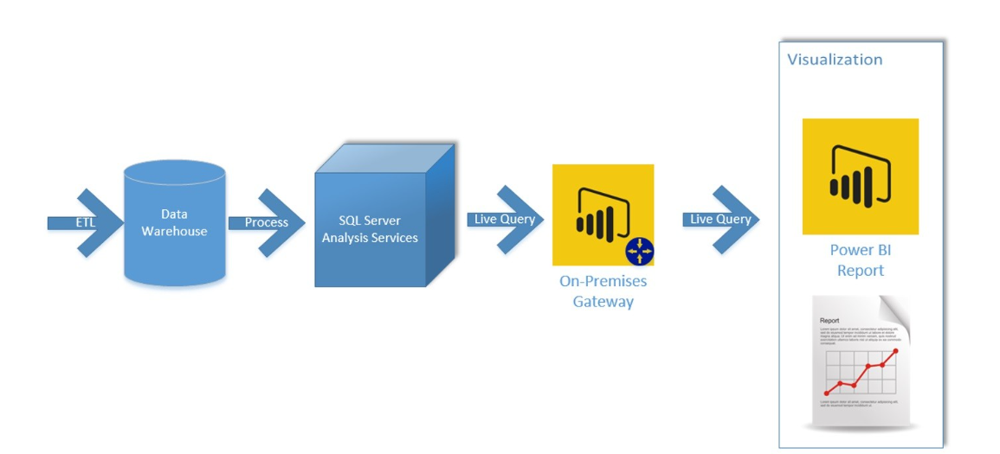
Connectivity modes in Power BI
In Power BI 3 types of connectivity modes for connecting the data from database.
Import:-
Default and most common connectivity type.
Allows you to import data from various sources into Power BI Desktop.
Data is loaded into the Power BI model, and you can use Power Query and DAX for transformations and calculations.
Suitable for most data sources and scenarios.
Direct :-
Available for specific data sources.
Power BI stores only metadata in the model, not the actual data.
When you interact with visuals, queries are sent directly to the data source. Power Query not work here and Data view hide.
Useful for scenarios where data needs to remain up-to-date in the source system and not stored within Power BI. Its ideal for large datasets that can not be loaded in memory.
Live :-
Only available for specific data sources: SQL Server Analysis Services, Azure Analysis Services, and Power BI Datasets in the Power BI Service.
No data is stored in the Power BI model.
Reports and visuals interact directly with the underlying data source.
Ideal for scenarios where you have a centralized data model hosted in Analysis Services or Power BI Service.

Slide 32
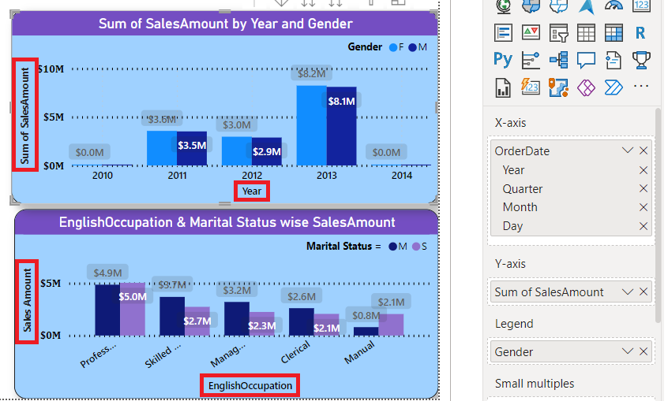
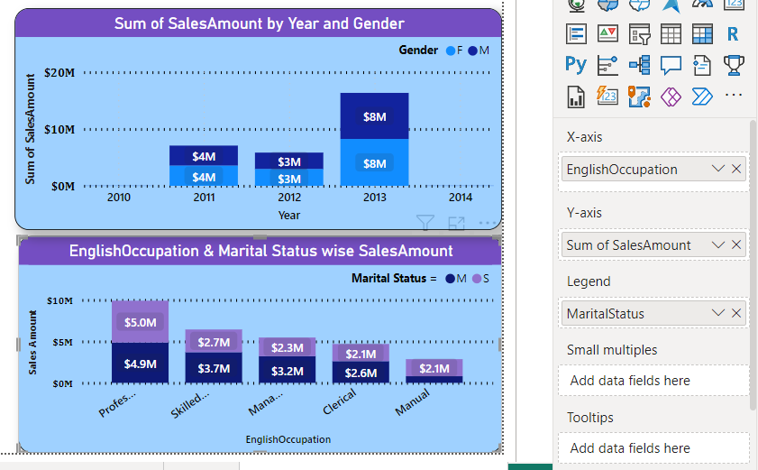
Charts / Visuals
A chart (sometimes known as a graph) is a graphical representation for data visualization, in which "the data is represented by symbols, such as bar chart, line chart, pie chart, column charts, cards etc.."
1) Column Chart
Clustered Column Chart:- This is a default column chart where all the categories are displayed against the same value category.
Stacked Column Chart:- These are the basic typed charts that allow the comparison of one category to another category.
Continue…

Slide 33
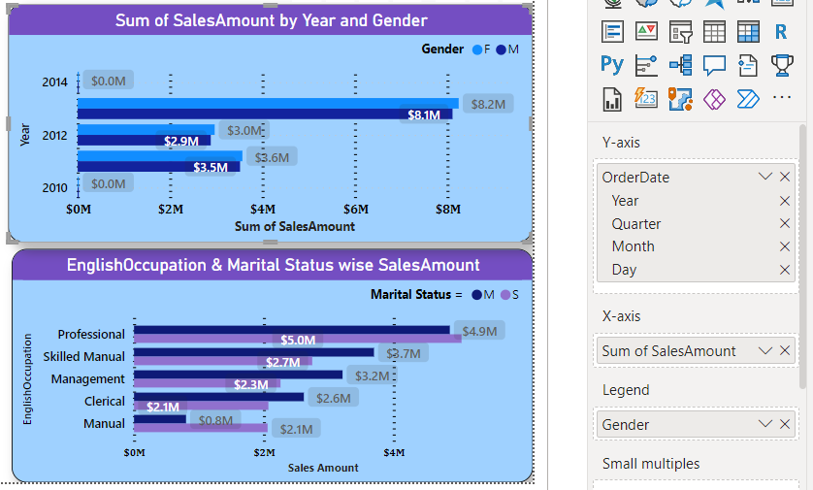
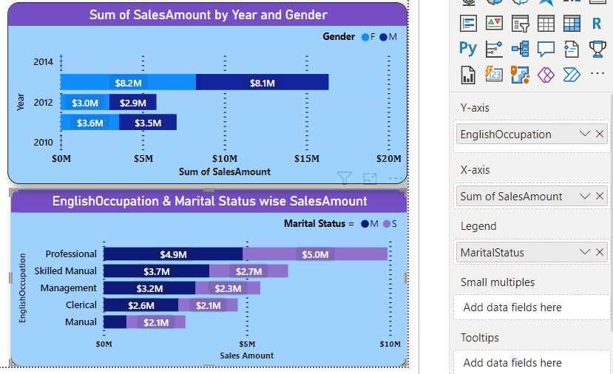
Charts / Visuals
2) Bar Chart
Clustered Bar Chart:- Clustered Bar charts are means to display a measure against a single dimension.
Stacked Bar Chart:- The stacked bar chart is used to compare Multiple dimensions against a single measure.
Continue…

Slide 34
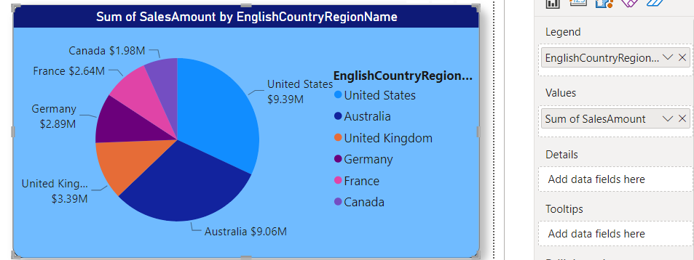
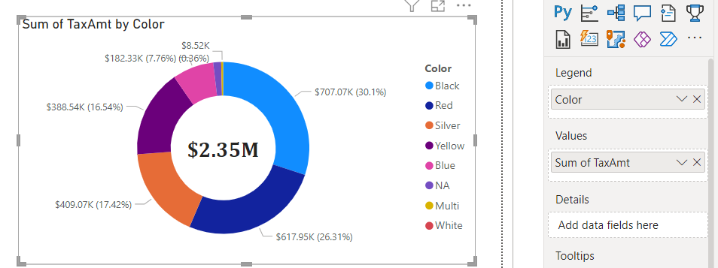
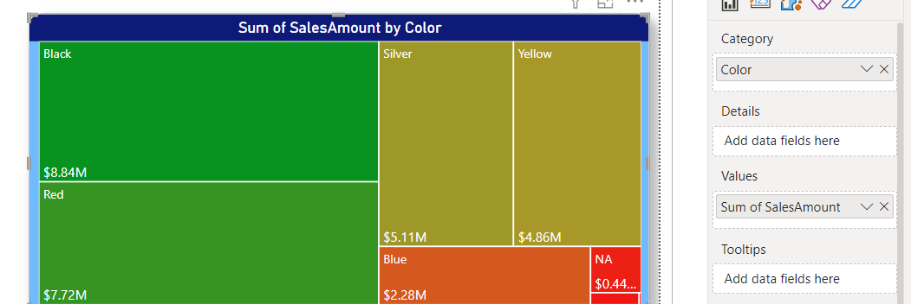
Charts / Visuals
3) Pie Chart:- Power BI Pie Charts are very useful for visualizing High-level data.
4) Donut Chart:- Donut charts are used to show the proportions of categorical data, with the size of each piece representing the proportion of each category.
5) Tree Map:- Power BI Treemap is used to display the data in Rectangle Boxes.
Use Color and Sales Amount for visualizing the data in tree map
Continue…

Slide 35
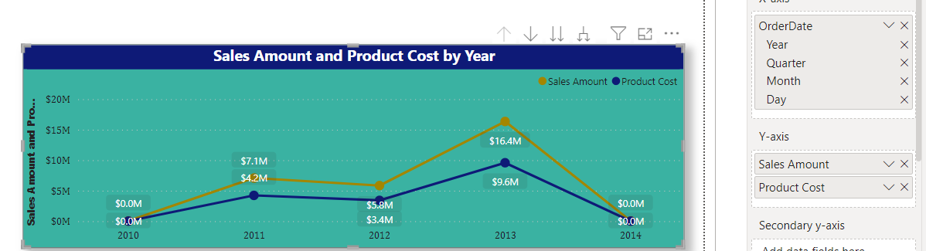
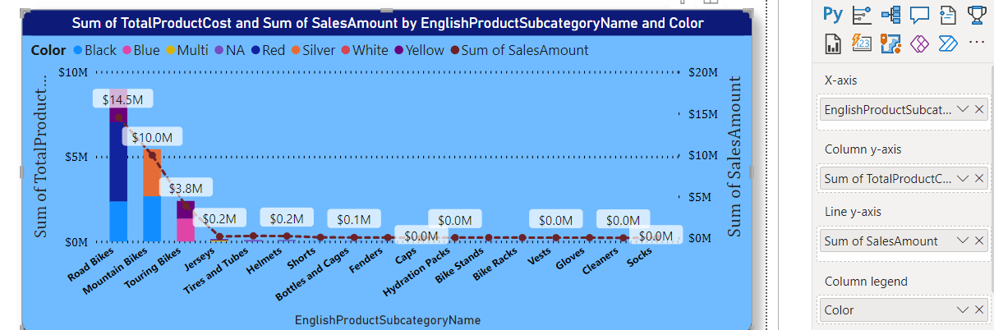
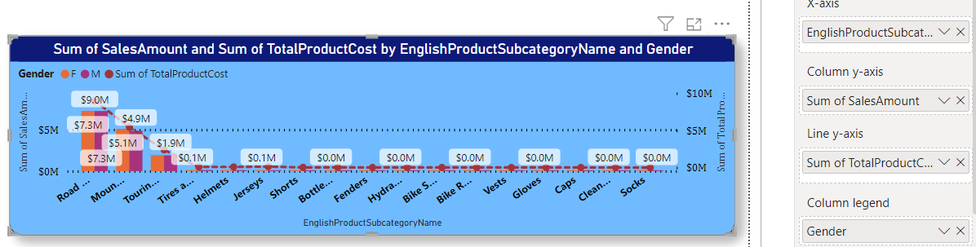
Charts / Visuals
6) Line Chart:- Power BI Line Chart is useful for visualizing Trends over time. For example, you can use this to create a Sales trend, Temperate Trend, etc.
7) Line + stacked column chart:- Power BI Line and Stacked Column Chart help you visualize multiple dimensions and measures.
8) Line + clustered column chart :- Power BI Line and clustered Column Chart help you visualize multiple dimensions and measures.
Continue…

Slide 36
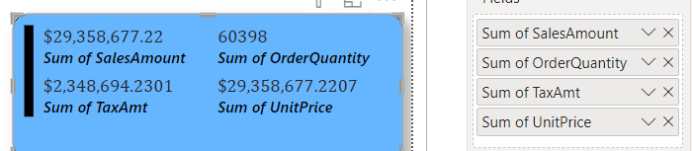
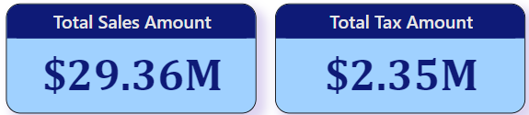
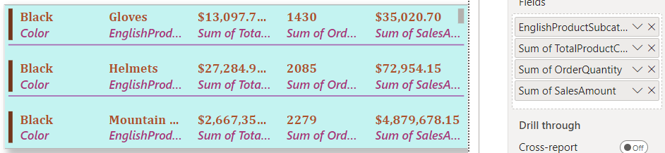
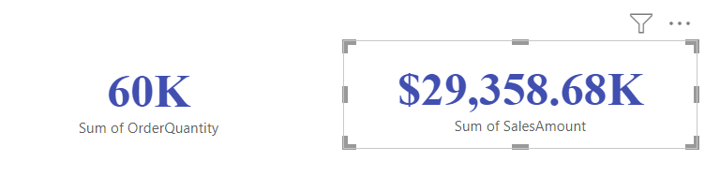
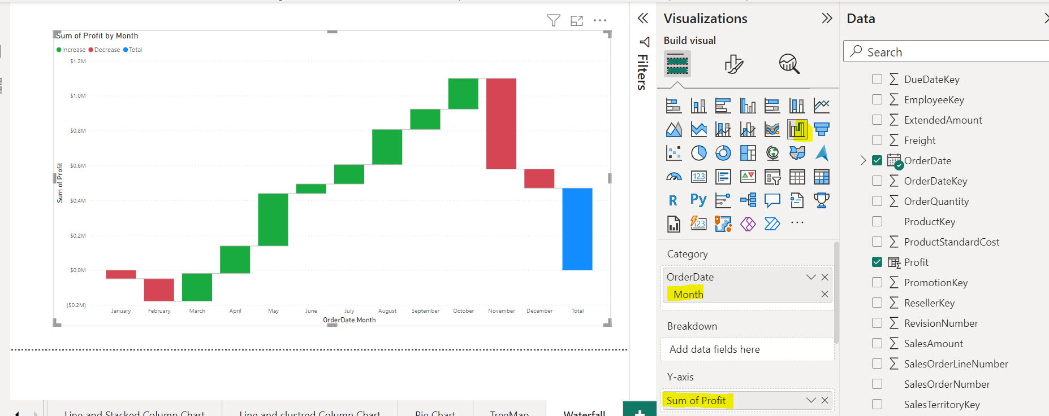
Charts / Visuals
9) Card : A card is useful to display a single number (or metric value).
E.g. :- Total sales, Total Qty etc..
10) Multi Row Card:- Power BI Multi-Row Card is useful to display the data in a Group format (or a section-wise).
11) Waterfall Chart: A Power BI waterfall chart is also called a bridge chart. It uses a series of continuous vertical bar columns showing the profit (gain) or loss. E.g:- Create calculated column in fact table
Profit =FactResellerSales[SalesAmount]-FactResellerSales[TotalProductCost]
Continue…

Slide 37
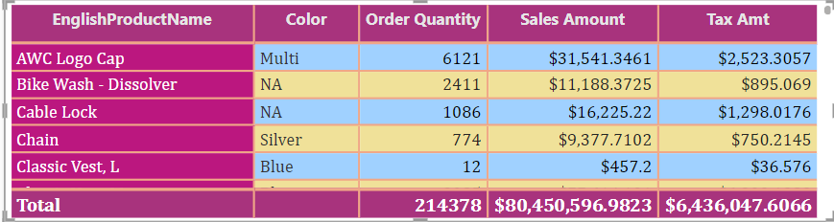
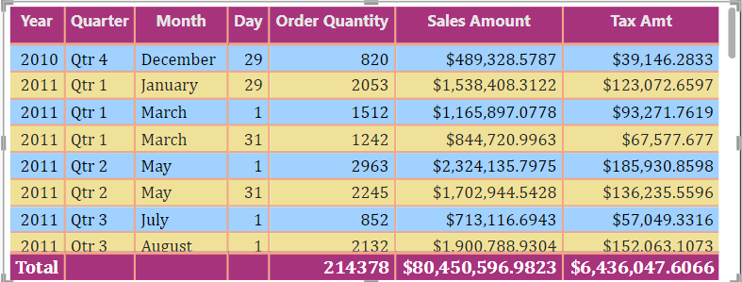
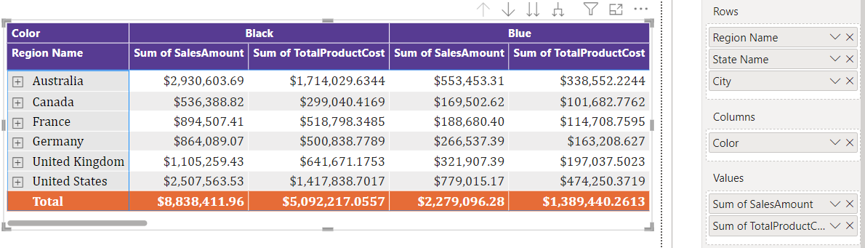
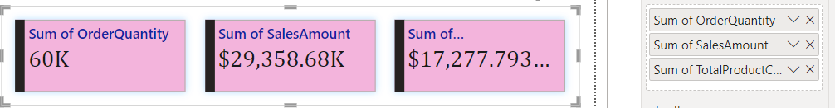
Charts / Visuals
12) Table: Display fields in tabular format. Date Hierarchy auto created based on Date column in visual.
13) Matrices : A Power BI Matrix is similar to a table that contains rows and columns. However, the matrix shows the aggregated data instead of displaying the detailed rows. The aggregation of the numeric measure depends on the column and row headers.
When to Use Matrix
To display the aggregated information in tabular format.
To perform row and column grouping.
To view row and column subtotals, totals, and grand totals.
To enable drill down action across the report.
14) Card New: It extends the functionality of a standard Card visual.
Unlike the standard card, which only supports one field, the Card (new) has a grid property.
This means you can add multiple fields on the same visual. It allows you to encapsulate the data in one card.
Continue…

Slide 38
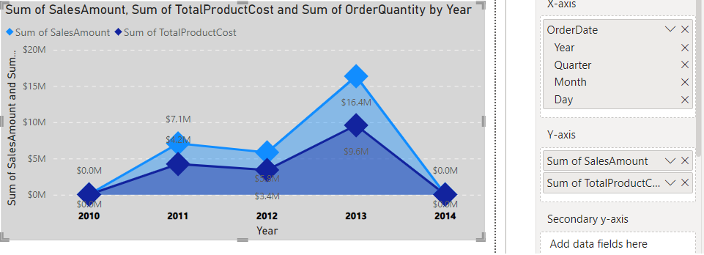
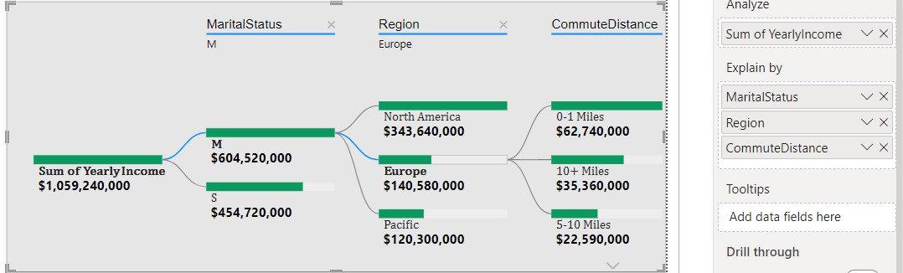


Charts / Visuals
15) Area Chart: We are plotted area between X and Y axis, Area chart is a combination of a line chart with an area covered below the line.
16) Decomposition Tree: We can use the decomposition tree to visualize data in multiple dimensions. We can drill down and analyze data in the hierarchy for a quick analysis.
18) Q&A: The Q&A feature in Power BI lets you explore your data in your own words. The first part of this article shows how you use Q&A in dashboards in the Power BI service.
17) KPI: Key Performance Indicator is a measure for business to understand how they perform in specific area that is important and many times critical for their business.

Slide 39
5) Advance Power BI

Slide 40




Bookmark
Bookmark: Bookmark in power bi helps you to capture the configured views of a report page in a specific time,
This includes filters and state of visuals which can use a short cut to come back to the report ha you can add as a bookmark.
Example:-
Continue…

Slide 41

Example:-

Slide 42


Tooltip
Tooltip: Its showing more contextual information details to data points on a visual
Tooltip Page
Tooltip report and setting
Flow of set Tooltip page
Canvas setting select Tooltip and
View →Page View → Actual Size

Slide 43

Filters
It is sort data and information based on some selected criteria, which is you can select particular fields or values within fields and view only the information related to that.
Types:- 1) Visual Level Filter
2) Page Level Filter
3) Report Level Filter
1) Visual Level Filter:- This filter applied directory on individual visualization. Such as filter applied both on data and calculation condition within a visualization.
Continue…

Slide 44




2) Page Level Filter:- The filter on particular page , In this page we have list of visualizations(Charts).
3) Report Level Filter:- This filter are applicable to all the pages in reports.
Basic & Advance filtering:- Restrict the data as per the requirement , Using logical operator we can use filter like as OR, AND, IS NOT, IS BLANK
TOP N:- Show the top or bottom values in the page reports or visual..
Continue…

Slide 45



Drill Through & Slicer (Sync Slicer)
Drill through Filter:- Users can right click on a pages then they can drill through to the focused page to get details that are filtered to that context.
Slicer:- Power BI Slicer is commonly used to add filters to the canvas or to display filters on the report canvas.
Sync Slicer:- It is sync to pages to where we need to filter on the basis of the existing slicer selection.
View→ Sync Slicer

Slide 46





Edit Interaction & Hierarchy & Drill up-Drill Down
Edit Interaction:- If you are click on any visual, automatically data filters on this page this is called interaction this is default behaviors of Power BI, User can manage visual interaction as per the requirement this is called as Edit interaction. (Format → Edit interaction)
Hierarchy:- Hierarchies in Power BI are a way to organize data in a hierarchical structure, where one parent or first level is ranked over the other.
Note:-(Use Query in Notepad)
Drill up-Down:- Drill-down in Power BI allows users to move from a higher level of data to a more detailed level,
while the drill-up feature allows users to move from a lower level of data to a higher level of data.

Slide 47


Conditional Formatting
Conditional Formatting:- You can specify customized cell colors including color gradients, bases on fields values, you can also represent cell values with data bar, KPI icons as well.
Row Level Security:- RLS with Power BI can be used to restrict data access for given users. Filters restrict data access at the row level, and you can define filters within roles.
We need to create the Roles based on filter criteria

Slide 48


Row Level Security (RLS)
Row Level Security:- RLS with Power BI can be used to restrict data access for given users. Filters restrict data access at the row level, and you can define filters within roles.
We need to create the Roles based on filter criteria , E.g. Need to restrict data based on SalesTerritoryGroup as per the below table. Below Roles need to be created in Modeling → Manage Roles→ View as Role.
1) [SalesTerritoryGroup] = "North America" , 2) [SalesTerritoryGroup] = "Europe"
3) [SalesTerritoryGroup] = "Pacific"

Slide 49
6) Data Analysis Expression (DAX)
Notes:
Data Analysis Expressions (DAX) is a formula expression language used in Analysis Services, Power BI, and Power Pivot in Excel.

Slide 50


Filter and Row Context
Filter Context:- The filter context is the set of filters applied to data model before the evaluation of DAX expression starts.
Slicers.
Filters on visual.
In Matrix visual based on row and column data fields.
Power BI filters.
Row Context:- In the row context exists in either a calculated column or an iterating DAX functions such as Sumx , Averagex, countx , filter & Addcolumns etc.
Below diagram we have created calculated column, in this column row by row calculation that is the reason this is row context.
Notes:
For Row context create calculated column in FactInternetSales table and use this DAX “Profit = SUM(FactInternetSales[SalesAmount])- SUM(FactInternetSales[TotalProductCost]”
we have added visual level filter, added filter on slicer and on the basis of this selection sum of profit is changed
Note: - First of all filter context applied and then evaluation working

Slide 51

Measure / Calculated Column /Calculated Table
Calculated Column :-
A calculated column is evaluated in a row context (row by row calculation).
A calculated column belongs to a single table.
Name Should be unique in the table level
Its allocated memory of data model
E.g.:- Sum Sales Amount_column = SUM(FactInternetSales[SalesAmount])
Measure:-
While a measure is evaluated in the filter context.
While a measure belongs to the whole data model.
Measure Name should be unique in model level.
Not physical consumption in the model. It run on the fly or on runtime
E.g.:- Sum Sales Amount_Measure = SUM(FactInternetSales[SalesAmount])
Calculated Table:-
A calculated table in power bi is a virtual table created through DAX expression that can be used for customized calculations and analysis within power BI data model.
Its return as a table.
E.g.:- Datetime= CalenderAuto()
Notes:
Note:- whenever we have created calculated column it’s not applicable for using filter context that is the reason its showing 29 M for each row.

Slide 52


SUM and SUMX
SUM | SUMX
SUM is used for simple aggregation | SUMX is used for Row wise calculation
Scalar Value | X is iteration function they perform row by row calculation
SUM (Column Name) | SUMX(Table, Expression)
Its give us scalar value | Iterating means to iterate through every single row and do a calculation.
Total Product Cost = SUM(FactInternetSales[TotalProductCost])
Profit_Measure = SUMX(FactInternetSales,FactInternetSales[SalesAmount]-FactInternetSales[TotalProductCost])
Notes:
Use Adventure work DW database

Slide 53
COUNT Functions
COUNT: - The COUNT function counts the number of cells in a column that contain numbers excluding empty rows. (Calculate Numbers, Dates, Strings)
Count= COUNT (Count_Source[StockQty])
Count_wBlank = COUNT(Count_Source[StockLevel]) -- The COUNT function will return BLANK when the entire column is blank.
COUNT_wDate =COUNT (Count_Source [Date] ) -- The COUNT function works with dates also.
Boolean_Count = COUNT(Count_Source[Boolean]) -- Error
COUNTA: -This is same like as COUNT but only function only difference is COUNTA is its calculating Boolean column values as well.
Boolean_CountA = COUNTA(Count_Source[Boolean])
COUNTROWS :- The COUNTROWS function counts the number of rows in the specified table, or in a table defined by an expression. COUNTROWS return a number.
COUNTROWS = COUNTROWS (Count_Source)
COUNTBLANKS :- The COUNTBLANK function counts the number of BLANK cells in a column.
COUNTBLANKS = COUNTBLANK (Count_Source [StockLocation] )
DISTINCTCOUNT:- The DISTINCTCOUNT function counts the number of unique data values in a column including blanks.
DISTINCTCOUNT =DISTINCTCOUNT (Count_Source [StockLocation] )
COUNTX:- The COUNTX() function allows us to extend the operation of COUNT(), and take, as an argument, an expression that is evaluated over a table. This example counts the number of products in stock where the stock quantity is over 100.
COUNTX= COUNTX ( FILTER (Count_Source, Count_Source[StockQty] > 100 ), Count_Source[StockQty])
Notes:
Use this file path “D:\Power BI Traning_Code\TraningSessionsSources\20.DAX\2.Count&All\Count_Source.xlsx”

Slide 54

CALCULATE Function
CALCULATE :- The CALCULATE function forms part of the filter function category and is defined as "evaluating an expression in a modified filter context." Create below measures
Total Sales = 'Order Details'[UnitPrice]*(1-'Order Details'[Discount])*'Order Details'[Quantity]
Sum of total sales = SUM('Order Details'[Total Sales]) – This is the simple DAX formula using sum
Cal Total sales = CALCULATE([Sum of total sales]) – Based on above DAX use calculate function
Cal w filter Total sales = CALCULATE([Sum of total sales], Products[ProductName]="Chai") – filter with Chai product
Calculate with All Products:- We can filter all the product on the basis of All selected product
Why this need: - we need to calculate percentage of total sales then this field is very useful.
Cal W All Products = CALCULATE([Sum of total sales],ALL(Products[ProductName])) – calculate with all product
% of sales = [Sum of total sales]/[Cal W All Products] -- calculate percentage
Notes:
Note:- Use Northwnd Database and Table names are (Categories, CustomerCustomerDemo, Customers, Employees, Order Details, Orders, Products, Shippers, Territories).

Slide 55


ALL & ALLSELECTED Function
ALL:- Returns all the rows in table, or all the values in a column, ignoring any filters that might have been applied.
TotalSales = CALCULATE(SUM('Sales Summary'[Net Sales]))
ALL_Total_Sales = CALCULATE(SUM('Sales Summary'[Net Sales]),ALL())
All_Sales_Product = CALCULATE(SUM('Sales Summary'[Net Sales]),ALL('Sales Summary'[Product]))
ALLSELECTED:- Returns all the rows in a table, or all the values in a column, ignoring any filters that might have been applied inside the query, but keeping filters that come from outside
ALLSELECTEDSales = CALCULATE(SUM('Sales Summary'[Net Sales]),ALLSELECTED('Sales Summary'[Product]))
Notes:
Use this file path “D:\Power BI Traning_Code\TraningSessionsSources\20.DAX\4.ALL&ALLEXCPTS&ALLSELECTED\dax-sample.xlsx”
ALL Column Name :- Country, Product and measures
Allselected column Name :- Country, Product , Net sales and Measure. Based on selection in slicer AllSELECTEDsales measure value changed

Slide 56

CALENDER() & CALENDERAUTO()
CALENDER:- Its returns tables with the single column named “Date” that contiguous set of dates. The range of dates is from the specified start dates and end dates.
Simple_Calender = CALENDAR (DATE (2015, 1, 1), DATE (2021, 12, 31))
Using CALENDER function create Date table and using ADDCOLUMNS function create calculated columns. (Create Calculate Table)
Calender =
Var A= CALENDAR(MIN(FactInternetSales[OrderDate]),MAX(FactInternetSales[OrderDate]))
Return
ADDCOLUMNS(A,"Year",YEAR([DATE]),
"Month",MONTH([Date]),
"Day",DAY([Date]),
"Month Name",FORMAT([Date],"MMM"),
"Year-Month", FORMAT([Date],"YYYY")& "-" & FORMAT([Date],"MMM"),
"Month-Year", FORMAT([Date],"MMM")& "-" & FORMAT([Date],"YYYY")
)
CALENDERAUTO:- Whenever you need to create date table based on fiscal year then CALENDERAUTO function used.
Fiscal Year Table = CALENDARAUTO(3)
Above Function created Date table and we need to create columns as per the requirement.
Month Name = FORMAT('Fiscal Year Table'[Date],"MMMM")
Fiscal Year Month Number = MONTH(EDATE('Fiscal Year Table'[Date],-3))
EDATE:-Returns the date that is the indicated number of months before or after the start date.
Fiscal Year Quarter Number = "Q-"& QUARTER(EDATE('Fiscal Year Table'[Date],-3))
Year-Month = FORMAT('Fiscal Year Table'[Date],"MMM YY") – popular format
If we need financial year like and 2021-22 then use below DAX
Fiscal Year =
VAR CurrentYear = Right(YEAR('Fiscal Year Table'[Date]),2)
VAR LastYear = Right(YEAR('Fiscal Year Table'[Date])-1,2)
VAR NewYear = Right(YEAR('Fiscal Year Table'[Date])+1,2)
VAR FiscalYear= SWITCH( TRUE(),
MONTH('Fiscal Year Table'[Date])>=4,
CurrentYear &"-"& NewYear,
NewYear &"-"& CurrentYear
) Return FiscalYear
Notes:
Explain Variable: - it is same like as declaring variable and return value for this variable as per the programming language.
When you are using the variable it’s improving DAX performance for calculating the fields.
----------------------------------
Fiscal year = Financial Year
-------------------------------
CalenderAuto (Year-Month ) samples examples
Year-Month = FORMAT('Fiscal Year Table'[Date],"YYYY MM")
Year-Month = FORMAT('Fiscal Year Table'[Date],"YYYY-MM")
Year-Month = FORMAT('Fiscal Year Table'[Date],"YYYY MMM")
Year-Month = FORMAT('Fiscal Year Table'[Date],"MMMM YYYY")

Slide 57



Time Intelligent DAX Functions
Sample time intelligent DAX functions
Todays_Date = TODAY()
Now_Day = NOW()
Birth_Date = Date(1991,10,12)
BirthYear = DATEDIFF([Birth_Date],Now(),YEAR)
Age = YEAR(TODAY())-1991
MTD/QTD/YTD :-
Total_MTD = TOTALMTD(SUM('Sales Summary'[Qty Sold]),'Sales Summary'[Sales Date]) – Create for QTD and YTD
The Total showing last month’s / Quarters / Years.
DATEADD
DATEADD= CALCULATE(SUM('Sales Summary'[Qty Sold]),DATEADD('Sales Summary'[Sales Date],-1,YEAR))
SAMEPERIODLASTYEAR: - Returns a table that contains a column of dates shifted one year back in time from the dates in the specified dates column
SAMEPERIODLASTYEAR= CALCULATE(SUM('Sales Summary'[Qty Sold]),SAMEPERIODLASTYEAR('Sales Summary'[Sales Date]))
DATEDIFF (Create calculated Columns)
Employee(Age) = DATEDIFF( 'Sales Summary_DATEDIFF'[BirthDate],TODAY(),YEAR)
Service Period = DATEDIFF('Sales Summary_DATEDIFF'[ Joining Date],TODAY(),YEAR)
Bonus = IF(DATEDIFF('Sales Summary_DATEDIFF'[Joining Date],TODAY(),Year)>3,"Eligible","Not Eligible")
Notes:
1)Create DAX table in Data model and store all the DAX in this table
2) MTD/QTD/YTD & DATEADD & SAMEPARIODLASTYEAR (Use dax-mtd-qtd-ytd-sample.xlsx file)
3) DATEDIFF (Use dax-datediff-sample-data.xlsx )
Note:- “D:\Power BI Traning_Code\TraningSessionsSources\20.DAX\6.Time Intelligent”

Slide 58


USERELATIONSHIP DAX Functions
If two tables are linked by more than one relationship, you can decide which relationship to activate by using USERELATIONSHIP.
SalesAmount_sum = CALCULATE(SUM(FactInternetSales[SalesAmount])) → calculated sum Sales Amount
SalesAmount_DueDate = CALCULATE(SUM(FactInternetSales[SalesAmount])) → calculated Due date wise Sales Amount
SalesAmount_OrderDate = CALCULATE(
[SalesAmount_sum],
USERELATIONSHIP(FactInternetSales[OrderDateKey],DimDate[DateKey])) → Calculate Order Date wise sales Amount
SalesAmount_shipdate = CALCULATE(
FactInternetSales[SalesAmount_sum],
USERELATIONSHIP(FactInternetSales[ShipDateKey],DimDate[DateKey])) → Calculate Ship Date wise sales amount
Notes:
Use Factinternetsales and DimDate table from AdventureworksDW database

Slide 59
Logical DAX Functions
Create Calculated Columns
SWITCH:-
COUNTRY_CODE = SWITCH('Sales Summary'[Country],"Canada","CA","Germany","GE","France","FR","No Match")
IN:-
IN Function = CALCULATE(SUM('Sales Summary'[Qty Sold]),'Sales Summary'[Product]IN{"Pen","Pencil"})
IF:-
IF Function = IF('Sales Summary'[Gross Sale]>=500,"Good","Need to Improve")
&&(AND):-
IF_&& Function= IF('Sales Summary'[Gross Sale]>=500 && 'Sales Summary'[Qty Sold]>=20,"Good","Need to Improve")
IF_AND Function = IF(AND('Sales Summary'[Gross Sale]>=500 , 'Sales Summary'[Qty Sold]>=20),"Good","Need to Improve")
||(OR):-
IF_|| Function= IF('Sales Summary'[Gross Sale]>=500 || 'Sales Summary'[Qty Sold]>=20,"Good","Need to Improve")
IF_OR Function1 = IF(OR('Sales Summary'[Gross Sale]>=500 , 'Sales Summary'[Qty Sold]>=20),"Good","Need to Improve")
Concatnation:-
Concat = CONCATENATE('Sales Summary'[COUNTRY_CODE],CONCATENATE("-",'Sales Summary'[Country]))
LEFT, RIGHT, MID:-
Flow: - Create calculated column →DATECode = FORMAT('Sales Summary'[Sales Date],"DDMMYYYY")
→using this create below DATE DAX
ProperDate_DATE =
VAR _date= LEFT('Sales Summary'[DATECode],2)
VAR _month= MID('Sales Summary'[DATECode],2,2)
VAR _year= Right('Sales Summary'[DATECode],4)
RETURN
_date&"-"& _month&"-"& _year
Notes:
1)Use dax-switch-data.xlsx (D:\Power BI Traning_Code\TraningSessionsSources\20.DAX\10.Logical_Function\dax-switch-data.xlsx)
2) After this explain “Live Connection Overview with SSAS and Power BI”

Slide 60
7) Power BI Service
Notes:
Login URL:- App.powerbi.com

Slide 61
Power BI service
Power BI License :-
Pro:-
1. As a Power BI developer, we need a Pro license, which is a per-user-based subscription. 2. Costs around 13 USD/month. 3. We can refresh around 8 times/day. 4. Model size cannot exceed 1GB. 5. We can share the reports internally and externally.
Premium:-
1. Capacity-based license (Say >=10,000 users). 2. Costs around 33k USD/month. 3. Can refresh 48 times/day. 4. Supports model up to 400GB.
PPU:-
1. User-based license. To use some of the advanced features of Power BI. 2. Premium per User License. 3. Costs around 20 USD/month. 4. Can refresh 48 times/day plus unlimited API refreshes. 5. Can have model size up to 100GB. 6. Microsoft introduced the PPU license for companies that are not big in their user base to use a premium capacity option but still want to use the premium functionalities.
Notes:
Pro user share the report to end user that person also required license for view the report.
Premium user share the report to end user then other person does not required the license to view the report.

Slide 62
Power BI service
Workspace :- this is like as a folder you can publish your report in this workspace and provide the access to end user , then end user are access you report at their end.
e.g. You can create workspaces Dev., test, prod OR year wise OR Business Name wise(HR, Sales Finance)
Publish Report :- You need to create report on Power BI desktop and login with email id and publish it in specific workspace.
Dashboard :- This is single page report, we can pin the visual on Power Bi service and create dashboard.
Workspace Access :- Manage Access and add user name for accessing the report.
Roles in workspaces in Power BI
Admin | Member | Contributor | Viewer
Add and remove peoples including other admin as well and also have permission to delete the whole workspace | He/she can only create, edit, delete content in workspace. Add members of others with lower permission in workspace | He/she can only create, edit, delete content in workspace. Provide permission to another user is not allowed (data model permission not available) | Only view the report
Continue…
Notes:
Note:- 1) You can create report Power BI service workspace-> Report→ existing semantic model
2) You can download the report in PBIX format open report →File Download file
3) Analyze in Excel → open report → Export →Analyze in Excel
4) Share :- You can share report to another user
5) Export data :- you can export data in specific visual

Slide 63

Create Report Using PBI service :-You can create report using Power BI service. (workspace-> Report→ existing semantic model)
Download :- You can download the report in PBIX format. (open report →File Download file )
Analyze in Excel :- (open report → Export →Analyze in Excel )
Share :- You can share specific report to another user. (Open Report → Share)
Export data :- you can export data in specific visual
Notes:
Note:- 1) You can create report Power BI service workspace-> Report→ existing semantic model
2) You can download the report in PBIX format open report →File Download file
3) Analyze in Excel → open report → Export →Analyze in Excel
4) Share :- You can share report to another user
5) Export data :- you can export data in specific visual

Slide 64




RLS , Gateway & scheduled refresh
1) RLS :-
First of all we need create the roles in Power Bi desktop
Add email group ids in this Power BI service.
In this scenario Male genders only see Male data and female gender only see female data.
2) Gateway:-
To refresh on premise data, its bridge between your data sources and report
Required dedicate server for this gateway
Should be run 24/7
Cloud data sources do not required gateway connection
Types of Gateway
Standard mode :- allows multiple users to connect to multiple on-premises data sources.
Personal Mode :- allows one user to connect to sources, and can’t be shared with others.
Install Gateway → connection with login id and password → its visible in Manage Gateway → go to seting gateway and cloud connection → add to gateway
3) Scheduled Refresh :-
You need to refresh Power BI dataset using gateway .
After added the data source go to Refresh and add scheduled refresh .
Notes:
Publish the report on Power BI service → go to dataset three dots → security → you are visible all the roles which are created on Power BI desktop.
Gateway free from Microsoft On-primises data sources ( Excel, SQL, Oracle, Txt File)
Gateway download Flow: - app.powerbi.com →go to download → Data gateway → download the gateway and install it.

Slide 65

Thank you !!!
“Process is more important than result, Keep Learning”

